Slide 1



QF632 Presentation
FINANCIAL
DATA SCIENCE
Group 13 Member:
CHEN Liangrui, MAI Jialing, WONG Keat Ye,
XIANG Sihan, XUE Yuanhuang

Slide 2


PROJECT 1

Slide 3
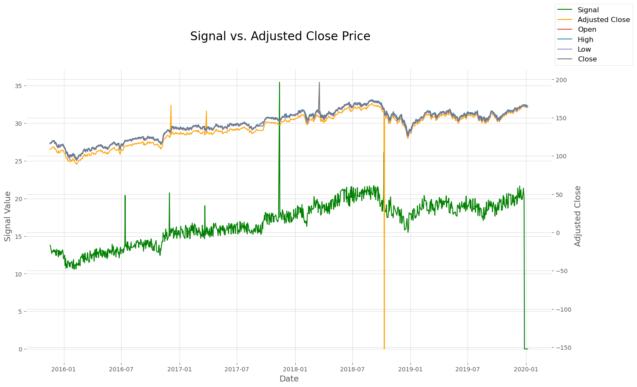
Project 1: Data Preview

Slide 4
Project 1: Data Preview
Potential error (Outlier)
** There are no missing value in this dataset.

Slide 5
Project 1: Identify and Correct Errors
Correct the negative adjusted close price
Date | Adjusted Close Price
2018-10-10 | -152.277847
abs()
Date | Adjusted Close Price
2018-10-10 | 152.277847
Correct the high and low value
Step 1 | Use max() and min() to find the highest and lowest value.
Step 2 | Identify which keys (Open, High, Low, Close) have the max and min values.
Step 3 | Check if any values need correction.
Step 4 | Swap values to ensure high is max and low is min.
Step 5 | Update the row with corrected values.
20 rows need correction

Slide 6
Project 1: Identify Outliers
Without Rolling Window
By measuring how many standard deviations a data point is from the mean of the dataset.
Z-score
(Threshold = 3)
Recommend
Rolling Window = 150
Approach
Without Rolling Window
Number of Estimators = 500
Contamination = 0.01
Random State = 42
Isolation Forest
Detect by isolating observations through recursive partitioning
Rolling Window = 200
Number of Estimators = 100
Contamination = 0.002 (Signal: 0.008)
Random State = 42

Slide 7
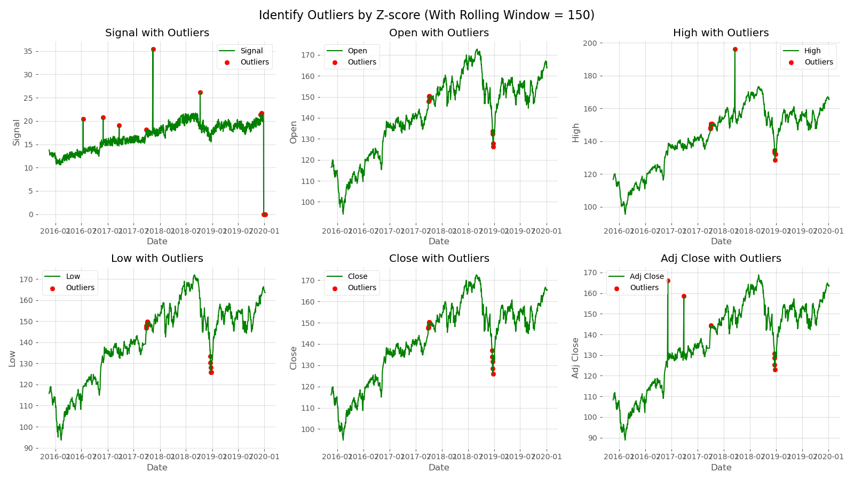
Project 1: Identify Outliers
Number of Outliers:
Signal: 14
Open: 10
High: 14
Low: 13
Close: 13
Adj Close: 8

Slide 8
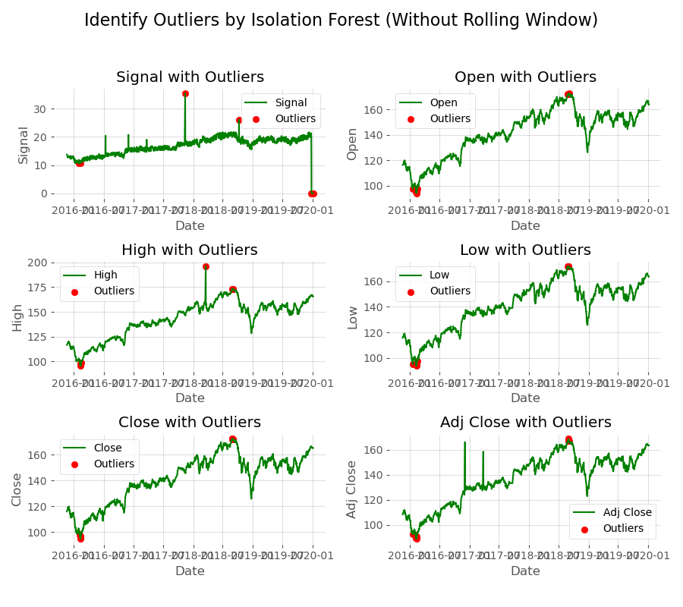
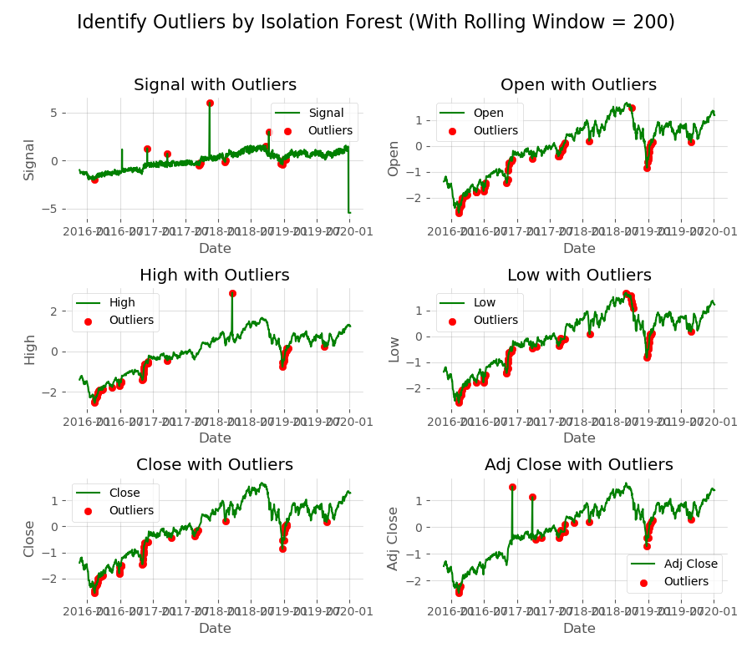
Project 1: Identify Outliers
Reason for Not Choosing Isolation Forest
Without Rolling Window
Rolling Window = 200
Reason:
Some of the obvious outliers are not caught.

Slide 9
Project 1: Interpolation by Using KNN Imputer
Steps
Step 1 | Get the indices of the rows where outliers are present.
Step 2 | Set the values to ‘None’.
Step 3 | Initialize the KNN Imputer. (n = 5, weights = uniform)
Step 4 | Impute missing values.
KNN fill in missing values by estimating them based on the characteristics of similar neighboring data points.
For Signal:
Date | Signal
2019-12-27 | 0.00
2019-12-30 | 0.00
2019-12-31 | 0.00
2020-01-02 | 0.00
2020-01-03 | 0.00
2020-01-06 | 0.00
Date | Signal
2019-12-27 | 20.463374
2019-12-30 | 20.451597
2019-12-31 | 20.436352
2020-01-02 | 20.436352
2020-01-03 | 19.906968
2020-01-06 | 19.906968
Before
After

Slide 10
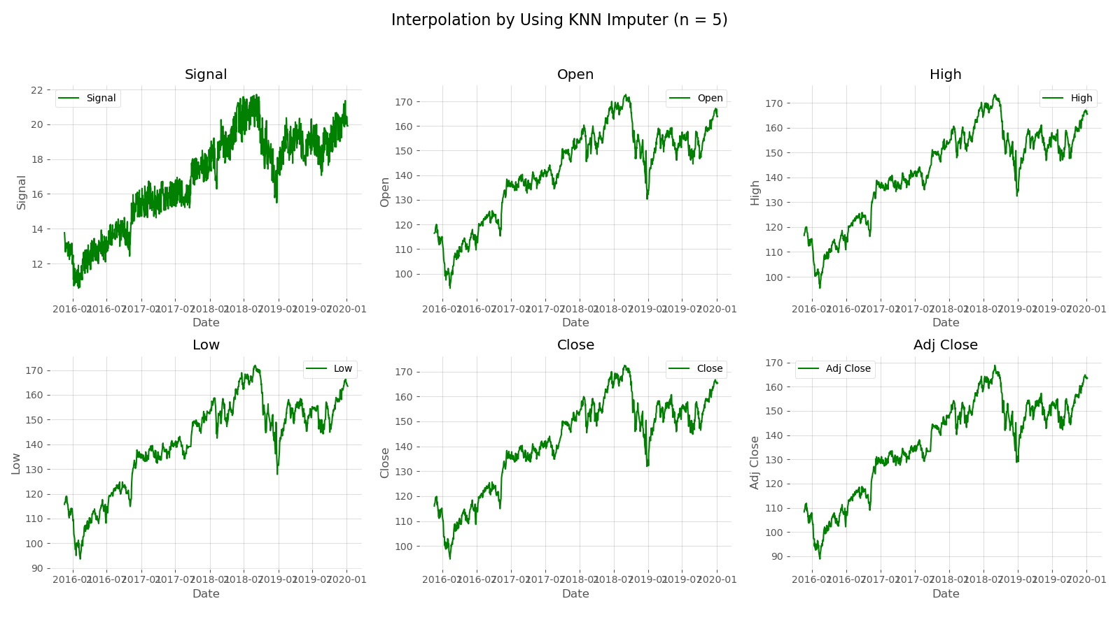
Project 1: Interpolation by Using KNN Imputer
Results

Slide 11
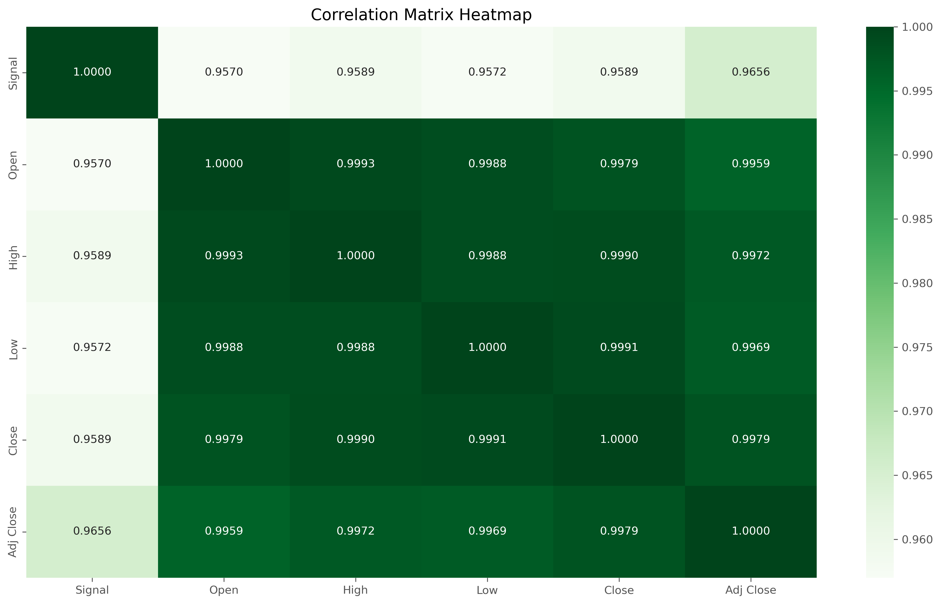
Project 1: Further Exploration – Correlation
‘Signal’ and ‘Adj Close’ have the highest correlation relationship.

Slide 12
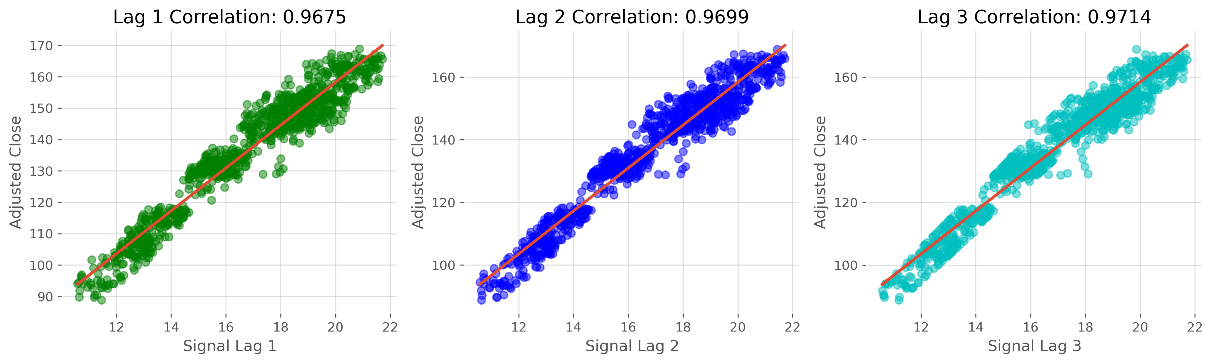
Project 1: Further Exploration – Time Lag Analysis
Steps
Step 1 | Create lagged signal columns. (lag = 1,2,3)
Step 2 | Calculate correlation with different lags and Adj Close.

Slide 13
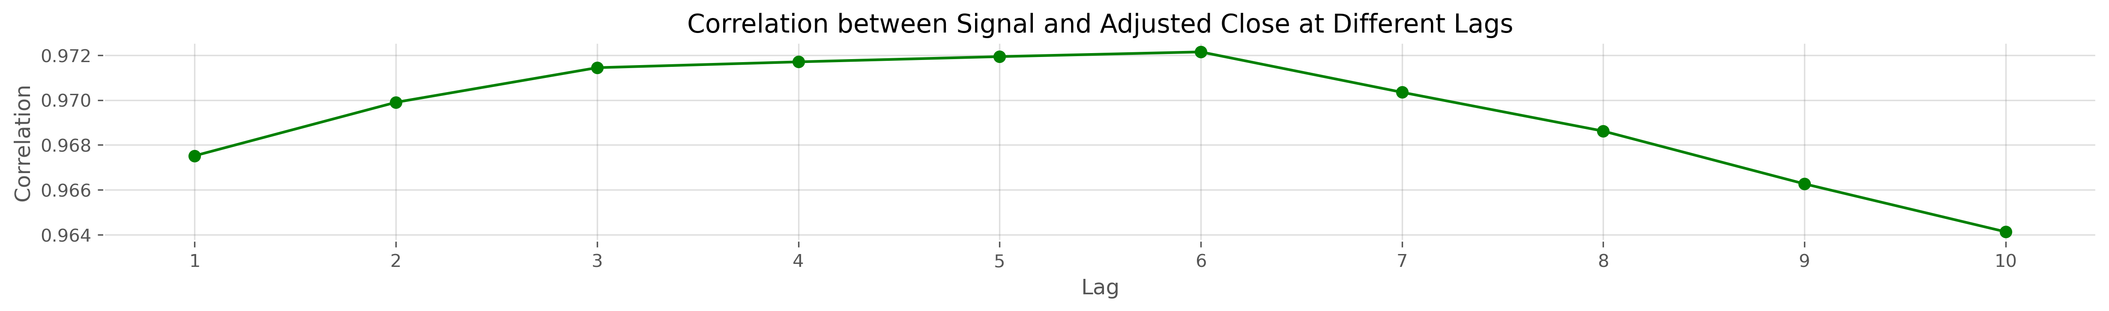
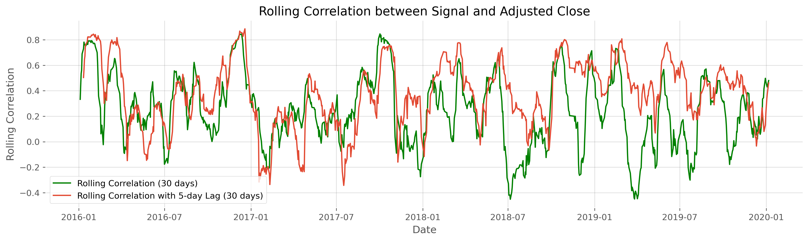
Project 1: Further Exploration – Time Lag Analysis
Steps
Step 3 | Determine the optimal lag. (lag = 1 ~ 10)
Recommend
(lag = 5)
Step 4 | Determine the rolling correlation.
Conclusion
The signal is most effective at predicting adj close price 5 days into the future.

Slide 14
Project 1: Further Exploration – OLS Regression Analysis
X: Signal (With or without lag)
Y: Adjusted Close Price
Key Metrics for Model Evaluation
Metric | Without Lag | With Lag = 5
R-squared | 0.9320 | 0.9450
Adj R-squared | 0.9320 | 0.9450
F-statistic (p-value) | 14270 (0.00) | 17600 (0.00)
AIC | 6070 | 6313
BIC | 6079 | 6323
Coefficients (Constant) | 21.3651 | 21.7657
Coefficients (Signal) | 6.8189 | 6.8571
R-squared and Adj R-squared
Higher values indicate that a larger proportion of the variance in the dependent variable is explained by the model.
F-statistic and p-value
Higher F-statistic values suggest a better overall fit of the model, while lower p-values indicate that the model is statistically significant.
AIC and BIC
Lower AIC and BIC values indicate a better model fit.
Coefficients
Higher coefficients indicate a stronger relationship between the independent variable and the dependent variable.
Conclusion
The model with a 5-day lag appears to have a better fit compared to the model without a lag.

Slide 15
PROJECT 2

Slide 16
Project 2: Data Cleaning and Preprocessing
Note
Standardize all the Factor Names in the Columns
df1: QF632_Project_2_a.csv.zip
df2: QF632_Project_2_b.csv.csv
df3: QF632_Project_2_c.csv.csv
df4: QF632_Project_2_d.csv.zip
Experience Level | Entry-level, Mid-level, Senior-level, Executive-level
Job Category | For the same job title name in df1 -> same category Other: Data Science and Research: Data Science & Marketing Data Scientist Machine Learning and AI: Prompt Engineer Others: Leadership and Management
Employment Type | Full-time, Part-time, Contract, Freelance
Work Setting | On-site, Remote, Hybrid
Employee Residence & Company Location | From country code -> country full name
Notes:
standardized the data, including experience levels, job categories, employment types, work settings, and the locations of employees and companies.
These standardization steps ensure data consistency, facilitating subsequent analysis.
After standardization, our data is more uniform and easier to understand, laying a solid foundation for further analysis.

Slide 17
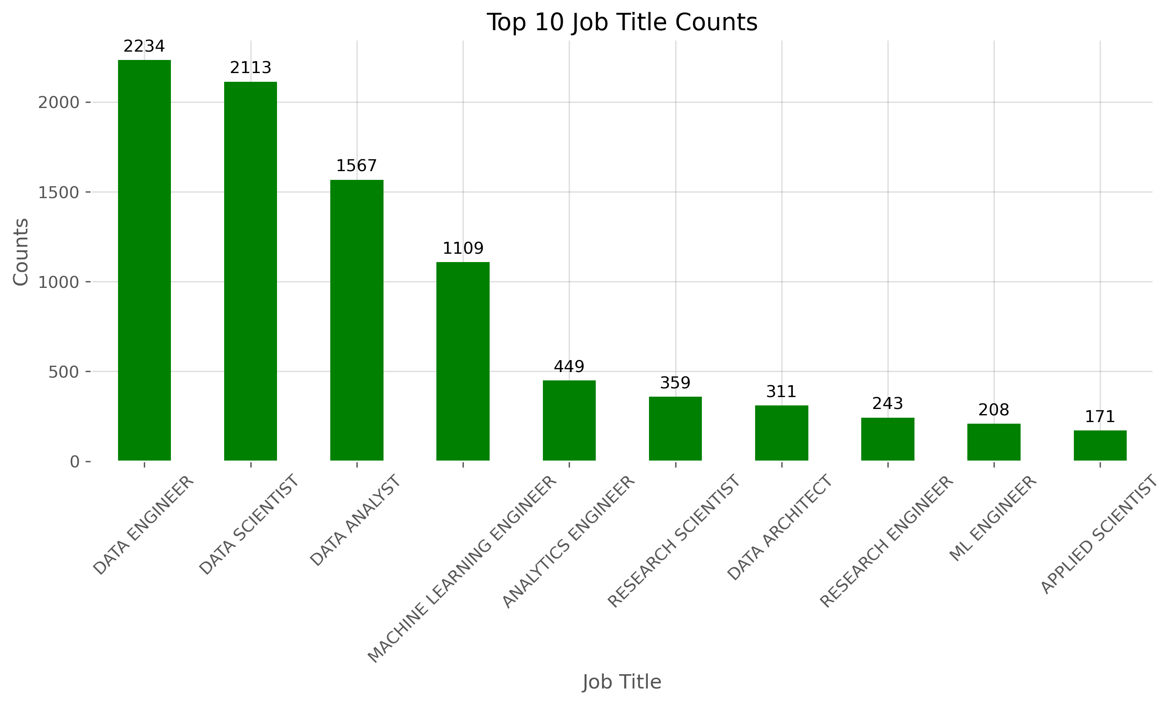
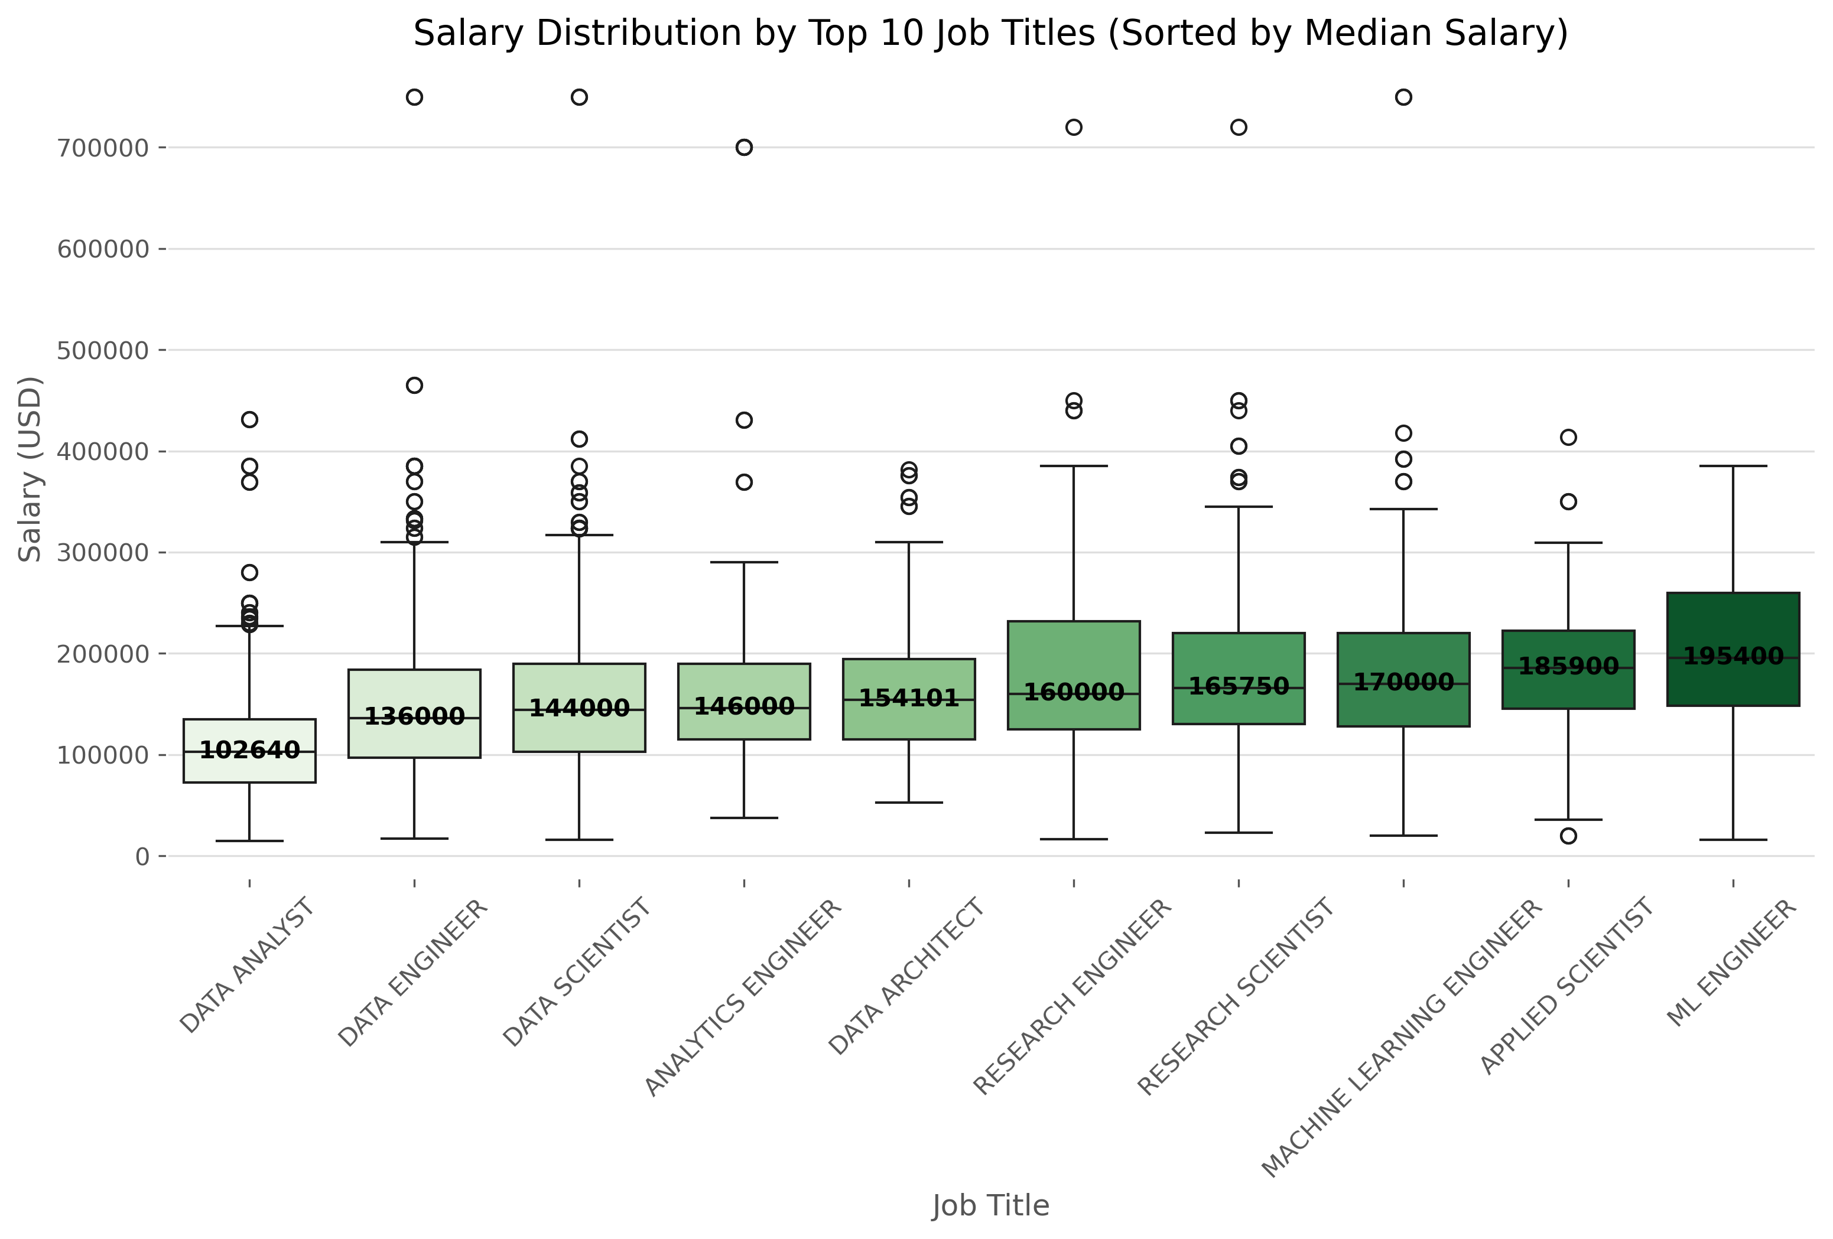
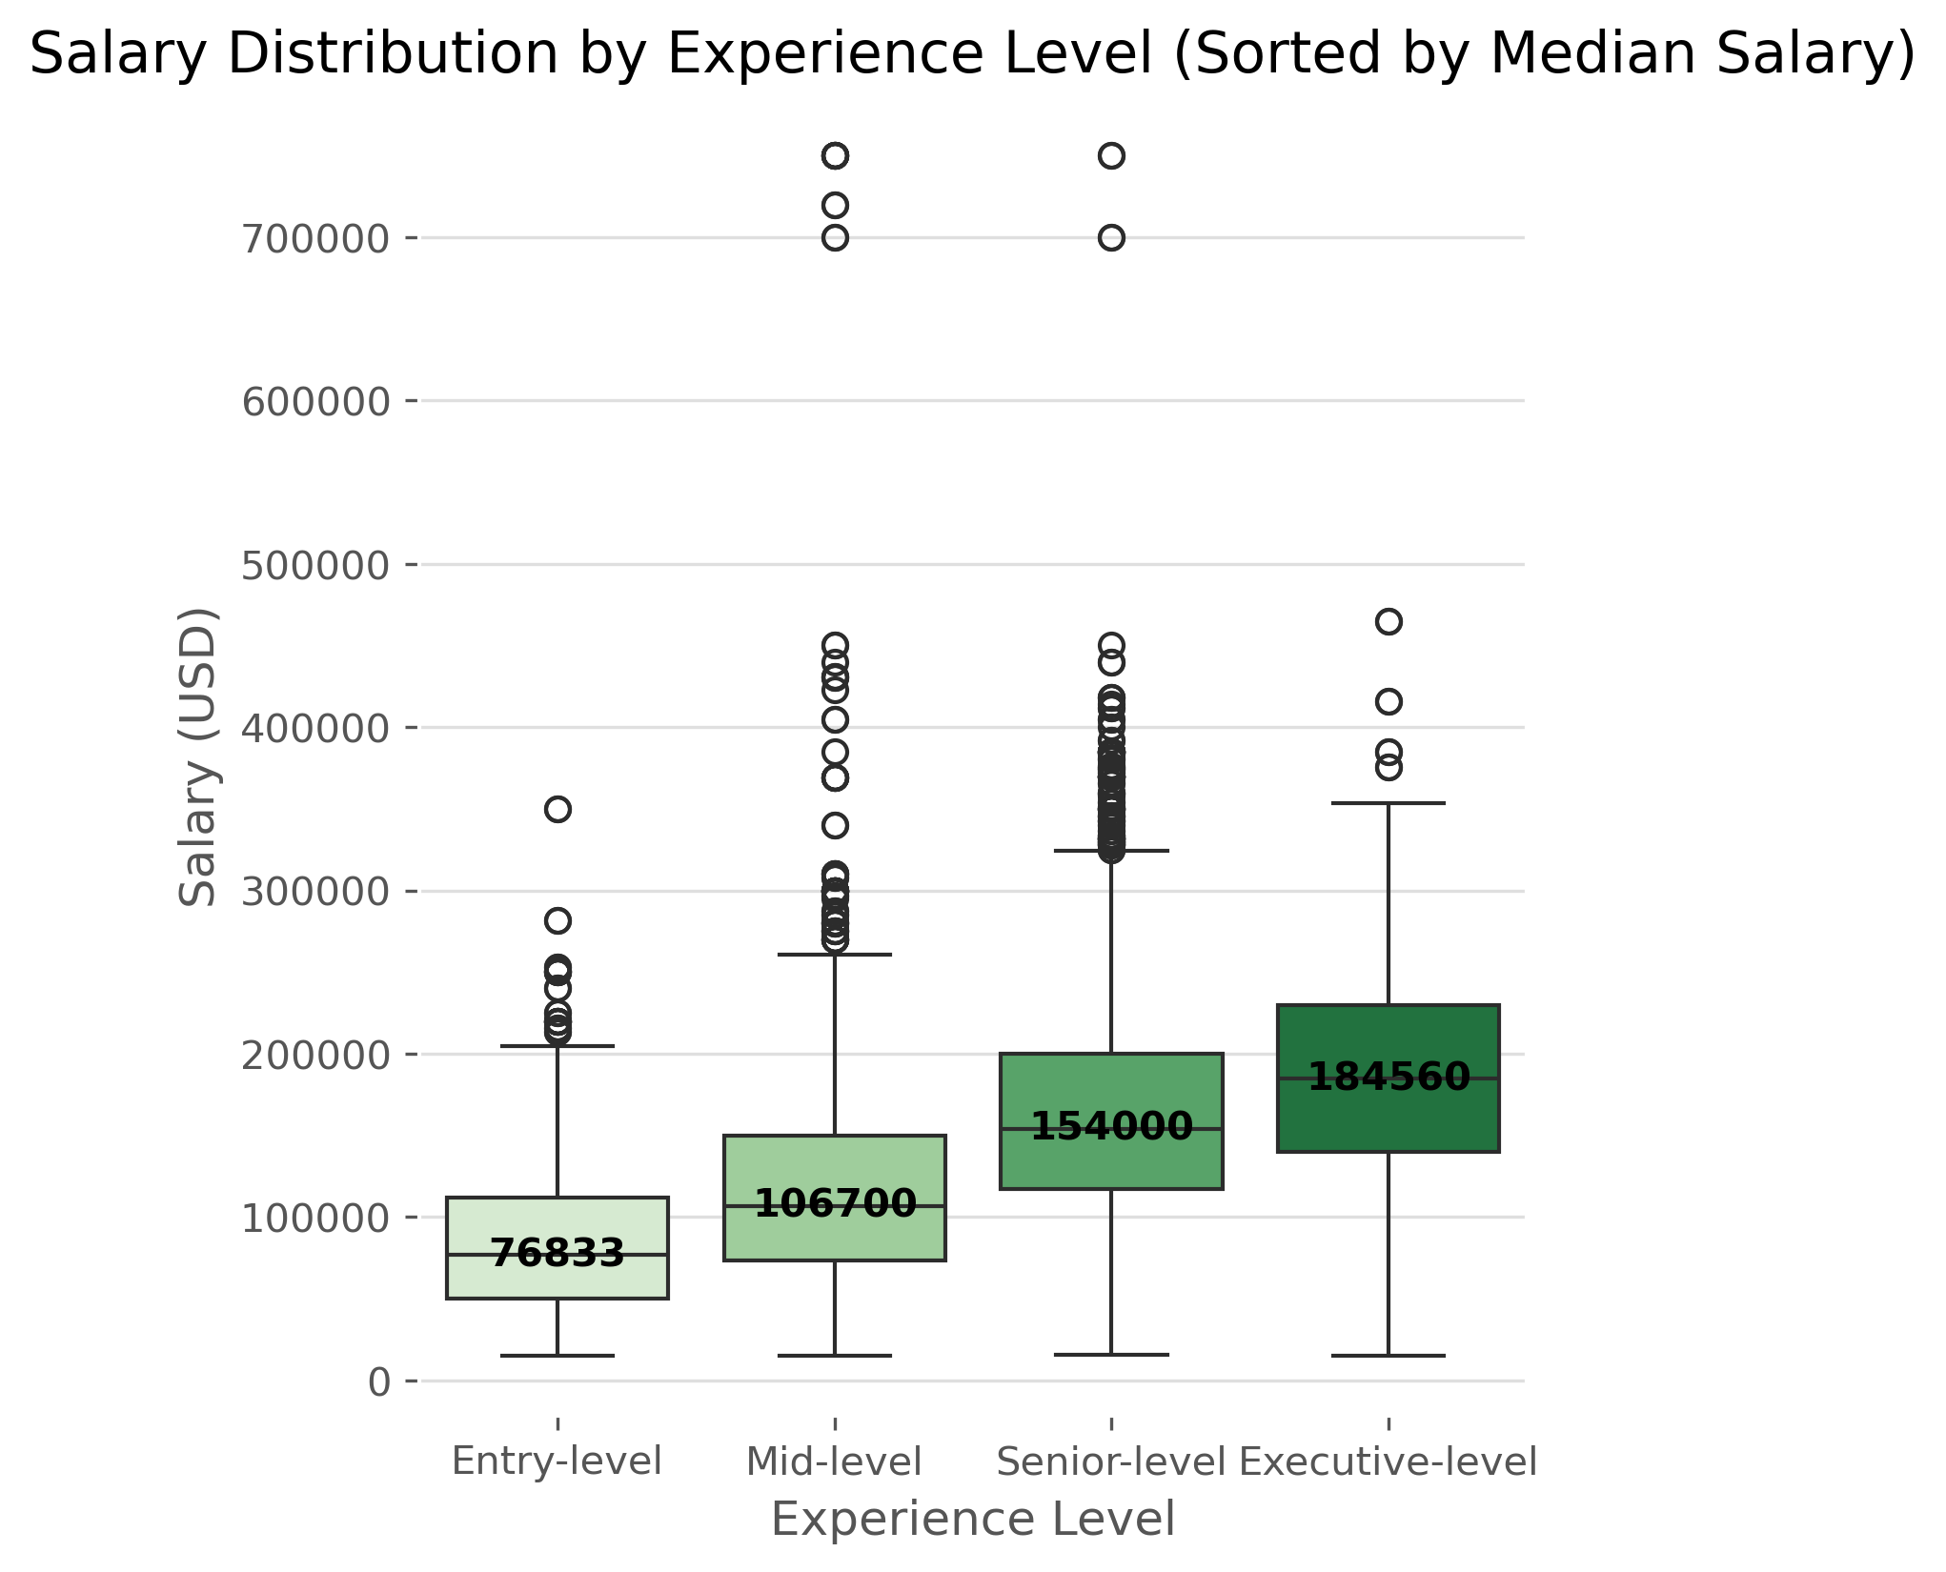
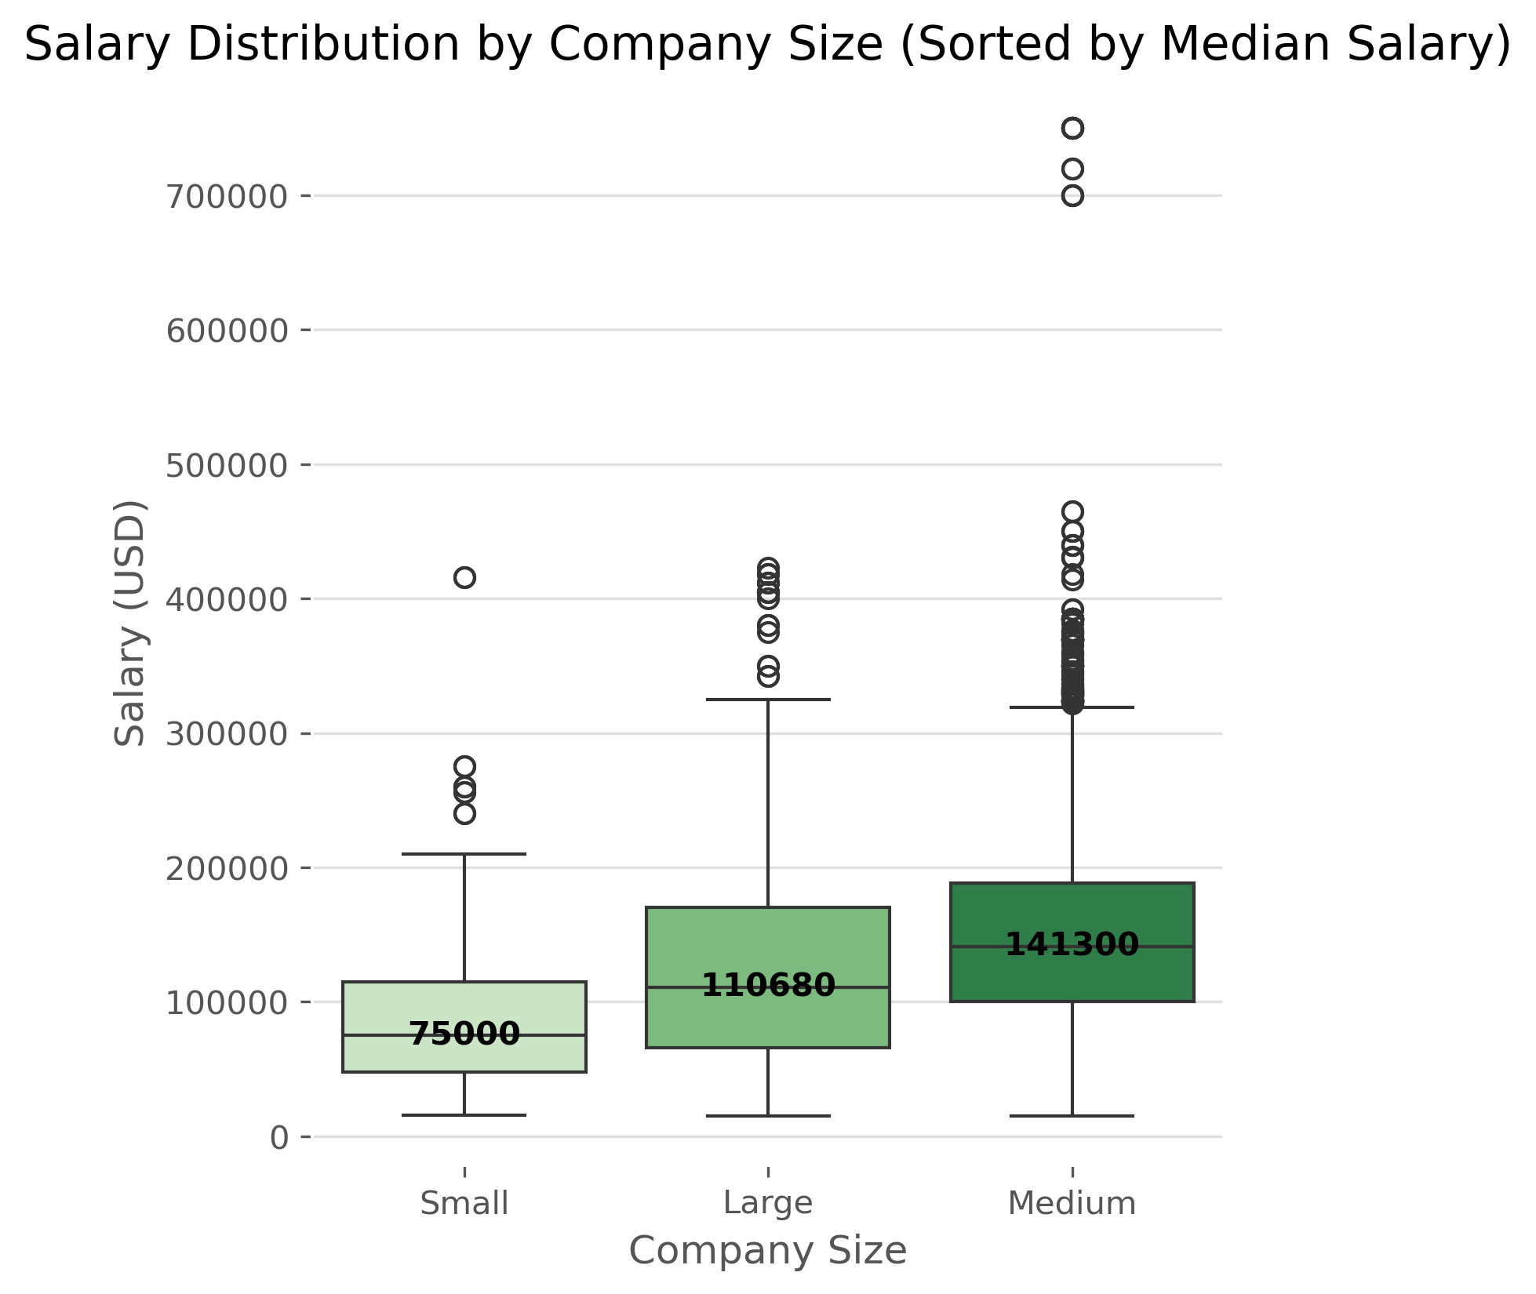
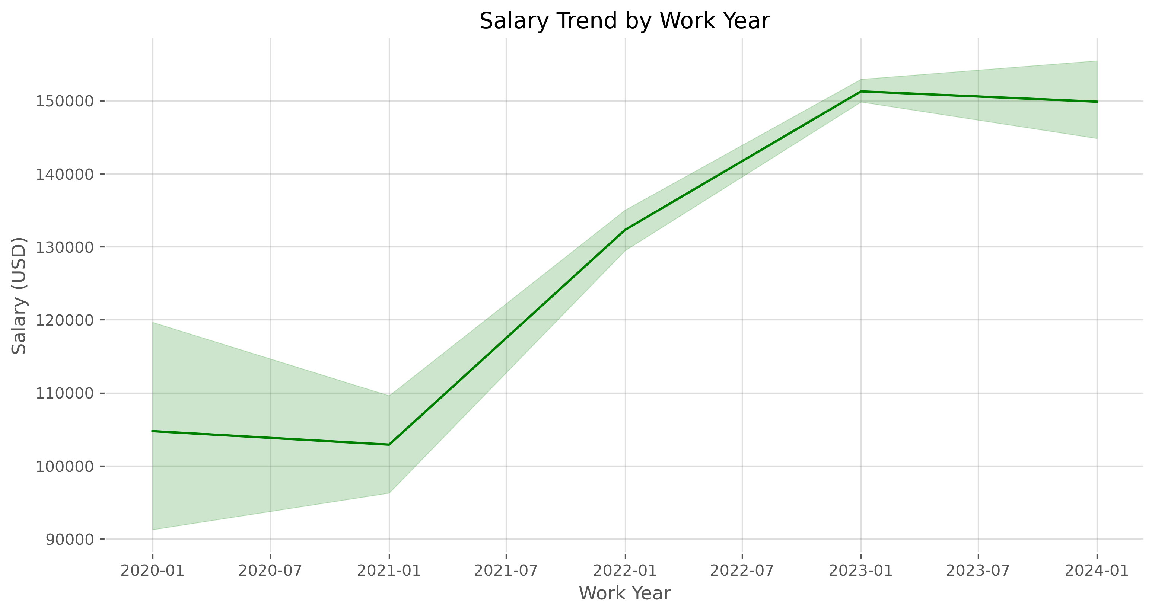
Project 2: Combined Data Frame (df1, df2 & df3)
Basic Visualization
Notes:
1. Data engineers and data scientists are the most common and highest-paying positions.
2. Machine learning engineers have the highest median salaries, but management positions also pay well.
3. Salaries increase with experience, with executive-level positions earning the most.
4. Surprisingly, medium-sized companies offer higher average salaries than large companies. We'll explore why in future research.
5. Salaries peaked in 2023, then slightly declined, with a broader distribution between 2023 and 2024.

Slide 18
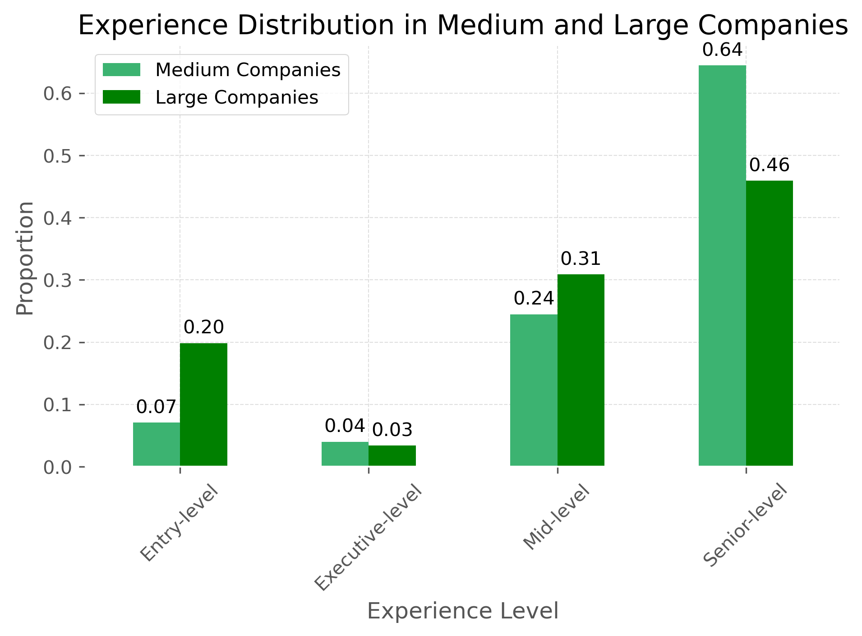
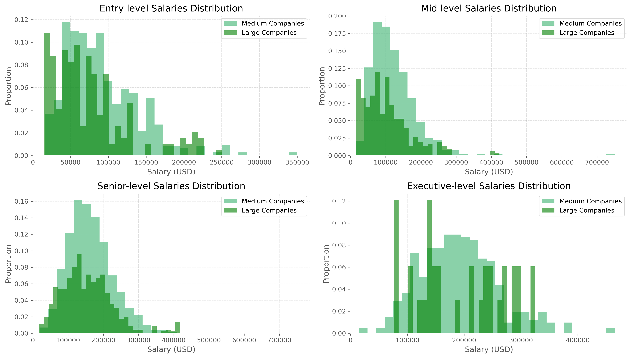
Project 2: Combined Data Frame (df1, df2 & df3)
Basic Visualization
Notes:
1. Medium-sized companies have a higher proportion of senior-level employees.
2. Large companies pay more at junior levels, but medium-sized companies offer better salaries at intermediate and senior levels.
3. Large companies offer higher salary ceilings for executive positions, but medium-sized companies have more balanced salary distributions.

Slide 19
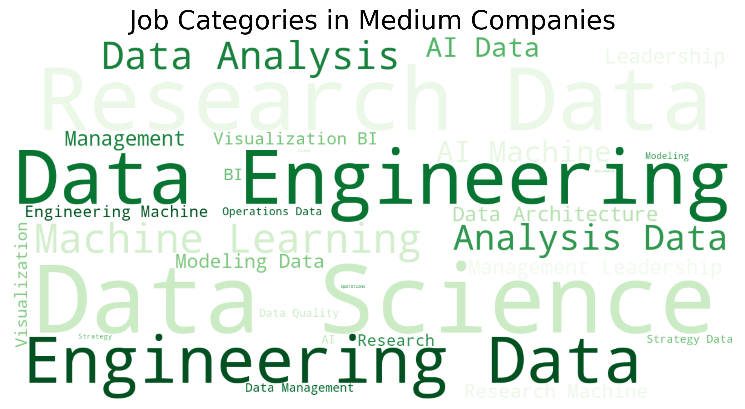
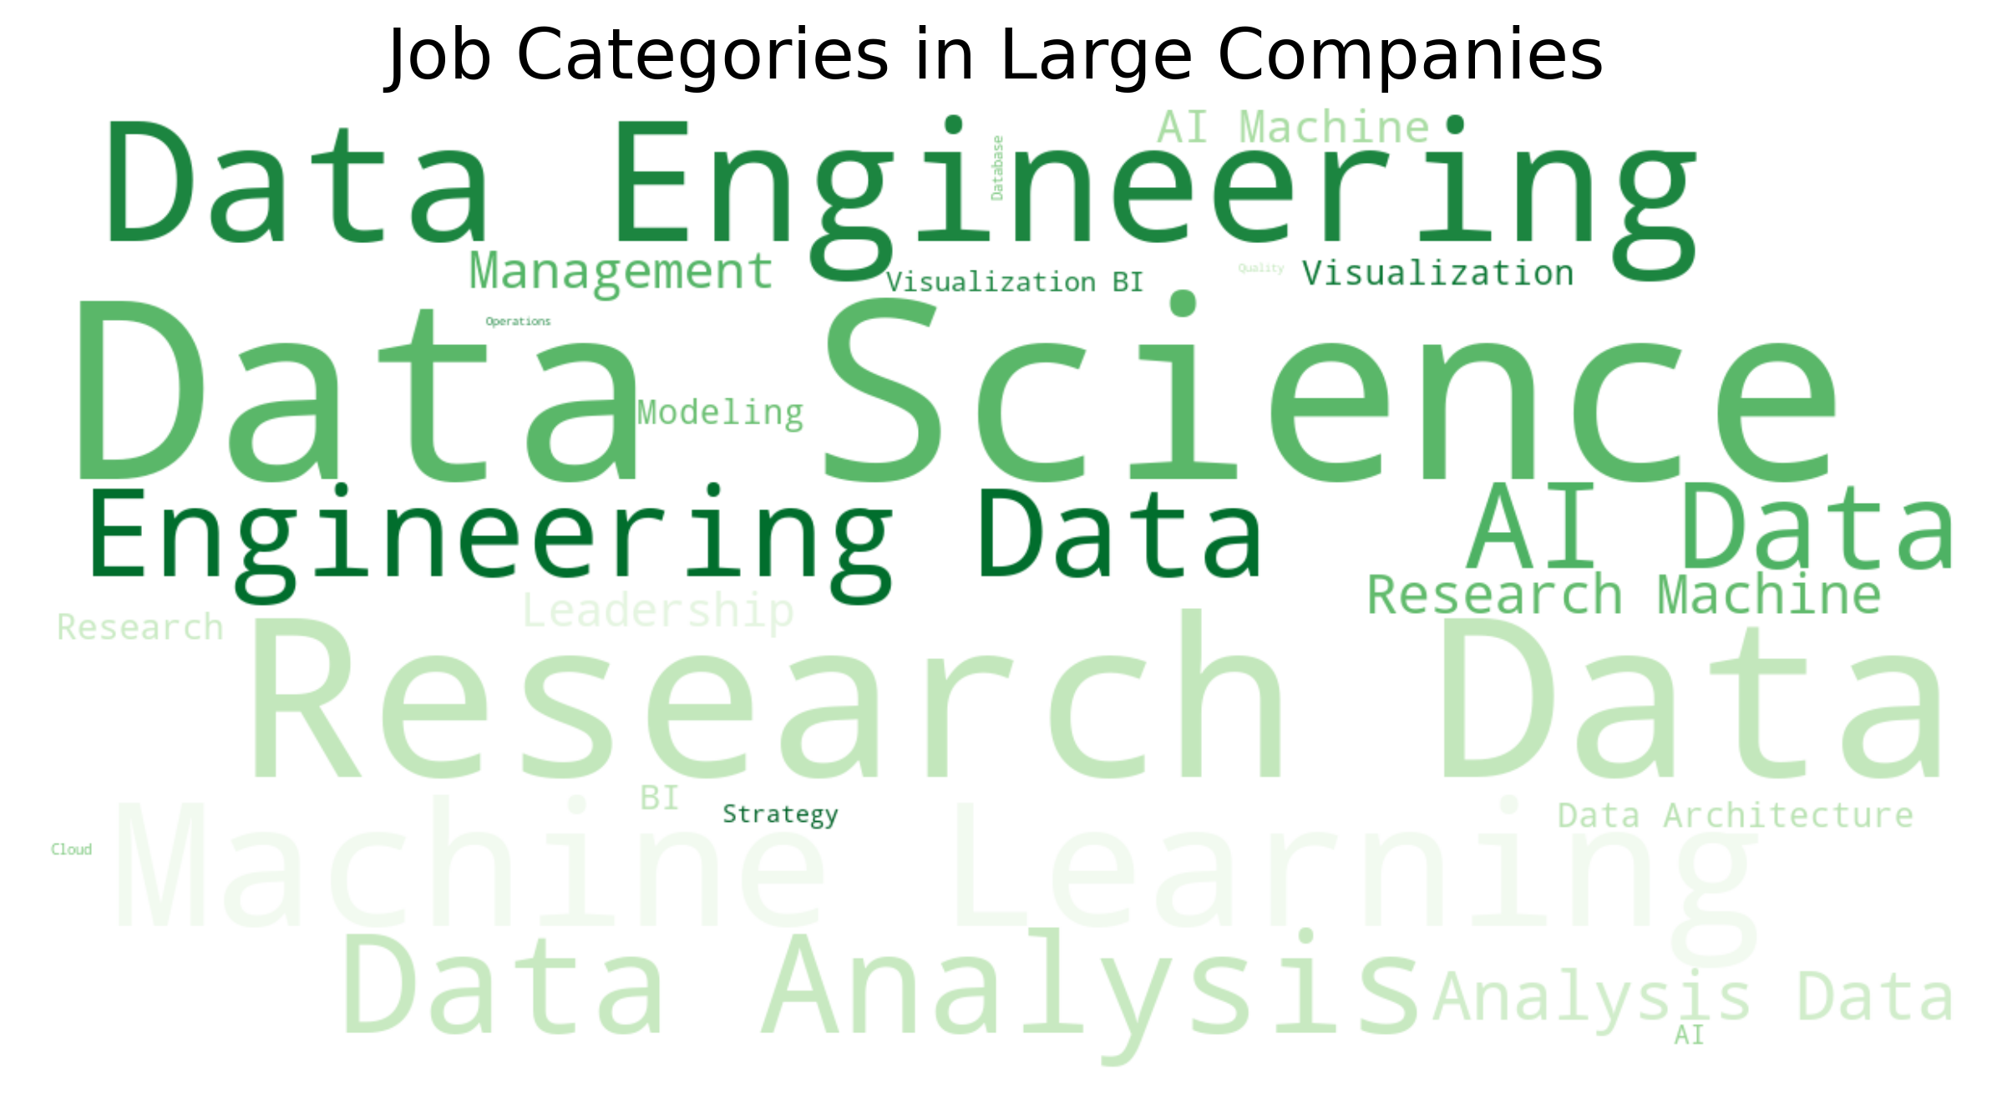
Project 2: Combined Data Frame (df1, df2 & df3)
Basic Visualization
Medium - Top 5 Job Categories with Average Salary
Large - Top 5 Job Categories with Average Salary
Machine Learning and AI | 181,701.66
Data Science and Research | 161,410.72
Leadership and Management | 148,049.77
Data Engineering | 146,993.20
Data Analysis | 108,536.95
Leadership and Management | 153,235.33
Data Science and Research | 133,290.30
Machine Learning and AI | 128,801.37
Data Engineering | 113,861.74
Data Analysis | 83,675.92
Notes:
Medium-sized and large companies have the highest demand for data engineering and data science positions. However, in terms of average salaries, medium-sized companies offer the highest salaries for machine learning and artificial intelligence positions, while large companies provide the highest salaries for leadership and management roles.

Slide 20
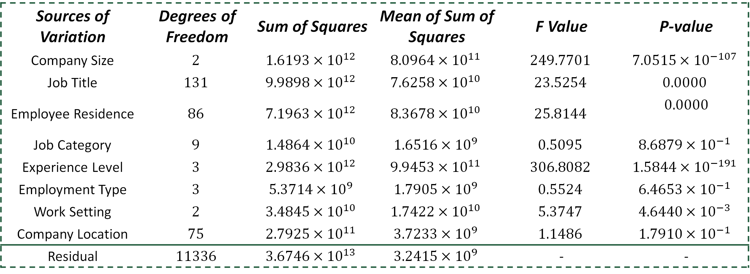
Project 2: Combined Data Frame (df1, df2 & df3)
Data Analysis – One-way ANOVA test
Sources of Variation | Degrees of Freedom | Sum of Squares | Mean of Sum of Squares | F Value | P-value
Company Size | $$2$$ | $$1.6193×{10}^{12}$$ | $$8.0964×{10}^{11}$$ | $$249.7701$$ | $$7.0515×{10}^{−107}$$
Job Title | $$131$$ | $$9.9898×{10}^{12}$$ | $$7.6258×{10}^{10}$$ | $$23.5254$$ | $$0.0000$$
Employee Residence | $$86$$ | $$7.1963×{10}^{12}$$ | $$8.3678×{10}^{10}$$ | $$25.8144$$ | $$0.0000$$
Job Category | $$9$$ | $$1.4864×{10}^{10}$$ | $$1.6516×{10}^{9}$$ | $$0.5095$$ | $$8.6879×{10}^{−1}$$
Experience Level | $$3$$ | $$2.9836×{10}^{12}$$ | $$9.9453×{10}^{11}$$ | $$306.8082$$ | $$1.5844×{10}^{−191}$$
Employment Type | $$3$$ | $$5.3714×{10}^{9}$$ | $$1.7905×{10}^{9}$$ | $$0.5524$$ | $$6.4653×{10}^{−1}$$
Work Setting | $$2$$ | $$3.4845×{10}^{10}$$ | $$1.7422×{10}^{10}$$ | $$5.3747$$ | $$4.6440×{10}^{−3}$$
Company Location | $$75$$ | $$2.7925×{10}^{11}$$ | $$3.7233×{10}^{9}$$ | $$1.1486$$ | $$1.7910×{10}^{−1}$$
Residual | $$11336$$ | $$3.6746×{10}^{13}$$ | $$3.2415×{10}^{9}$$ | - | -
$H_{0} :$ There is no difference among group means.
$H_{α} :$ At least one group differs significantly from the overall mean of the dependent variable.
Reject null hypothesis if p-value is less than 0.05.
Conclusion
The independent variables: company size, job title, employee residence, experience level and work setting are significantly impacting the change of salary.
Notes:
Using one-way analysis of variance (ANOVA), we examined the impact of different factors on salaries. The results show that company size, job title, employee location, experience level, and work setting significantly influence salary variations. Factors with a p-value less than 0.05 are considered to have a significant impact on salaries, providing an important basis for our subsequent in-depth analysis.

Slide 21
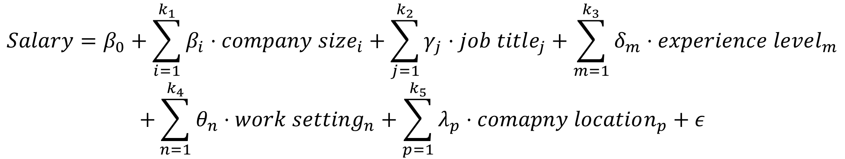
Project 2: Combined Data Frame (df1, df2 & df3)
Data Analysis – Multiple Linear Regression Model
$$Salary=β_{0}+\sum_{i=1}^{k_{1}}{β_{i}⋅company size_{i}}+\sum_{j=1}^{k_{2}}{γ_{j}⋅job title_{j}}+\sum_{m=1}^{k_{3}}{δ_{m}⋅experience level_{m}}$$
$$+\sum_{n=1}^{k_{4}}{θ_{n}⋅work setting_{n}}+\sum_{p=1}^{k_{5}}{λ_{p}⋅comapny location_{p}}+ε$$
Intercept
Error term
$β_{i},γ_{j},δ_{m},θ_{n},λ_{p}$ are the coefficients of the levels of the categorical variable
Results
R-squared: 0.365
Adj. R-squared: 0.353
F-statistic: 30.57
Coefficients:
The coefficient for medium-sized companies is 6055.06, indicating that, controlling for other variables, salaries at medium-sized companies are $6,055.06 higher than the baseline (large companies).
The coefficient for small companies is -25520, indicating that, controlling for other variables, salaries at small companies are $25,520 lower than the baseline (large companies).
Various job titles, experience levels, and locations also have significant effects on salary.
Notes:
We used a multiple linear regression model to analyze salary factors, explaining 36.5% of the variation. Dummy variable encoding was used for categorical variables like company size, job title, experience level, work setting, and company location.
Results show that medium-sized companies offer higher salaries than large companies, while small companies offer lower salaries. Job title and experience level significantly impact salaries, with executive-level positions and on-site work settings earning higher salaries.

Slide 22
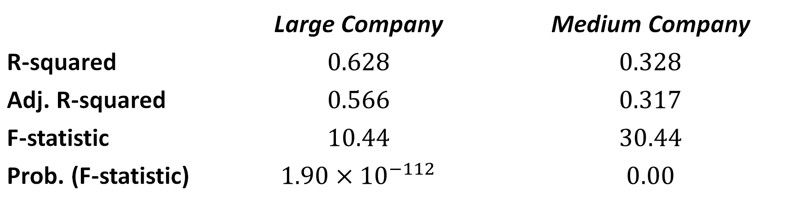
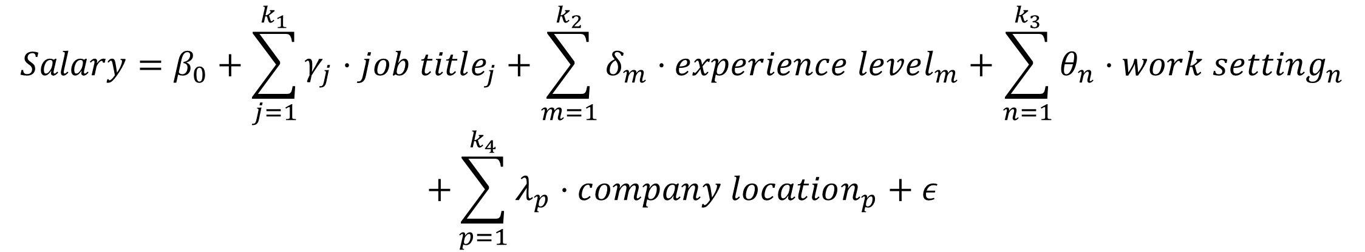
Project 2: Combined Data Frame (df1, df2 & df3)
Data Analysis – Multiple Linear Regression Model (For Large and Medium Company ONLY)
$$Salary=β_{0}+\sum_{j=1}^{k_{1}}{γ_{j}⋅job title_{j}}+\sum_{m=1}^{k_{2}}{δ_{m}⋅experience level_{m}}+\sum_{n=1}^{k_{3}}{θ_{n}⋅work setting_{n}}$$
$$+\sum_{p=1}^{k_{4}}{λ_{p}⋅company location_{p}}+ε$$
Intercept
Error term
$γ_{j},δ_{m},θ_{n},λ_{p}$ are the coefficients of the levels of the categorical variable
Results Comparison
 | Large Company | Medium Company
R-squared | $$0.628$$ | $$0.328$$
Adj. R-squared | $$0.566$$ | $$0.317$$
F-statistic | $$10.44$$ | $$30.44$$
Prob. (F-statistic) | $$1.90×{10}^{−112}$$ | $$0.00$$
Notes:
The results show that the model for large companies has a stronger explanatory power (R²=0.628), while the model for medium-sized companies has a relatively lower explanatory power (R²=0.328). This indicates that in large companies, factors such as job title, experience level, work setting, and company location have a more significant impact on salaries.

Slide 23
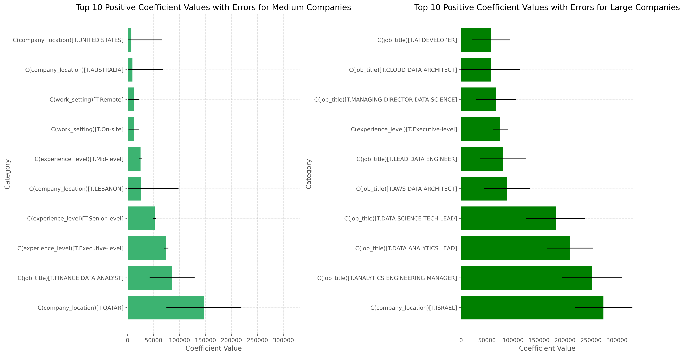
Project 2: Combined Data Frame (df1, df2 & df3)
Data Analysis – Multiple Linear Regression Model (For Large and Medium Company ONLY)
Notes:
M
Top 10 positive coefficient values
1.employees in the United States, Australia, and Qatar have significantly higher salaries.
2. both remote and on-site work have a positive impact on salaries.
3. intermediate, senior, and executive-level employees earn significantly more than junior employees.
L
4. AI developers, cloud data architects, and data science management directors have significantly higher salaries.
5. employees in Israel have significantly higher salaries.

Slide 24
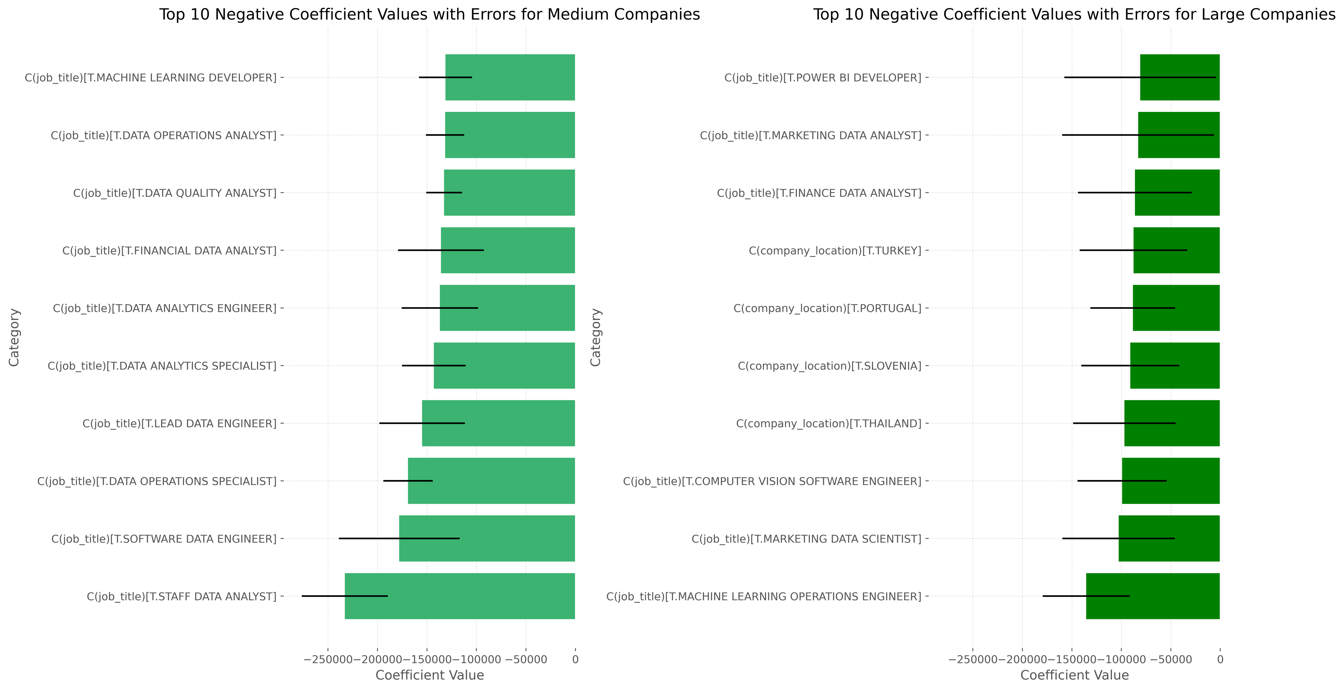
Project 2: Combined Data Frame (df1, df2 & df3)
Data Analysis – Multiple Linear Regression Model (For Large and Medium Company ONLY)
Notes:
Medium-Sized Companies
1. Machine learning developers, data operations analysts, and data quality analysts have significantly lower salaries.
2. Financial data analysts and data analysis engineers also earn less.
Large Companies
3. Employees in Turkey, Portugal, Slovenia, and Thailand have significantly lower salaries.
4. Financial data analysts and marketing data analysts earn less.
5. Computer vision software engineers and machine learning operations engineers also have lower salaries.

Slide 25
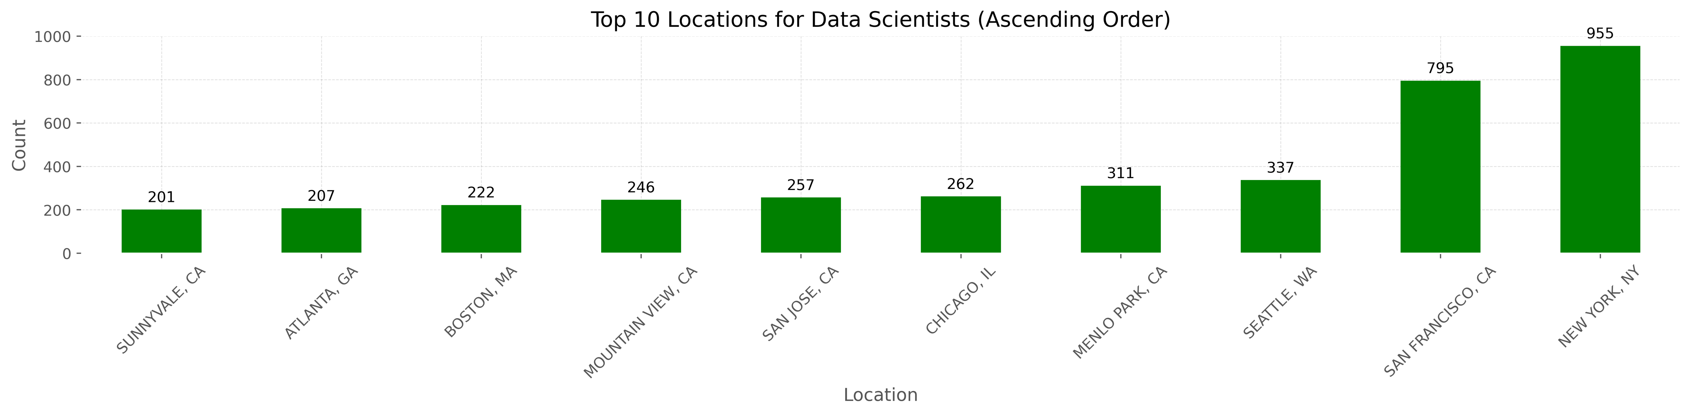
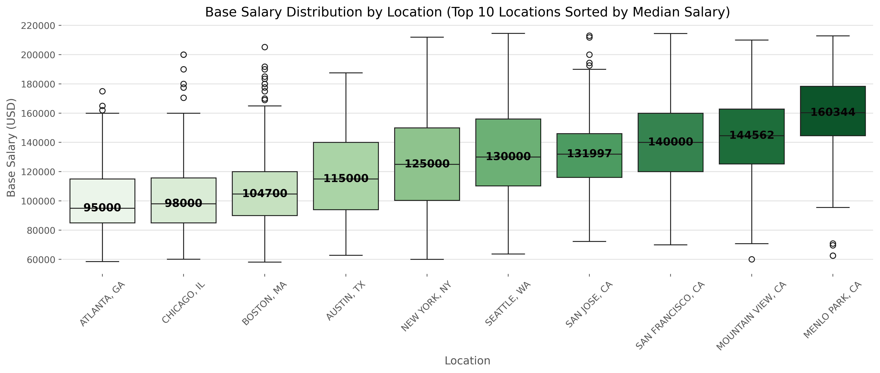
Project 2: Combined Data Frame (df4 & h1b data)
Data Visualisation
Notes:
This chart shows the distribution and base salaries of data scientists in the top ten regions. While New York and San Francisco have the most data scientists, Menlo Park offers the highest salaries.

Slide 26
PROJECT 3
Notes:
I will be presenting Project 3, which focuses on building a better company classification scheme

Slide 27
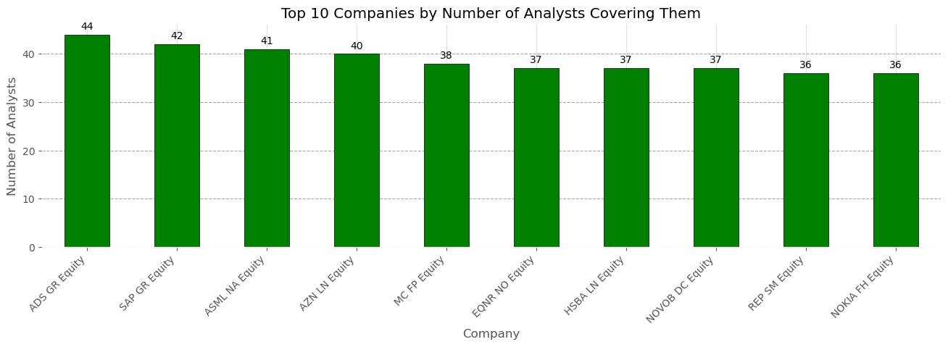
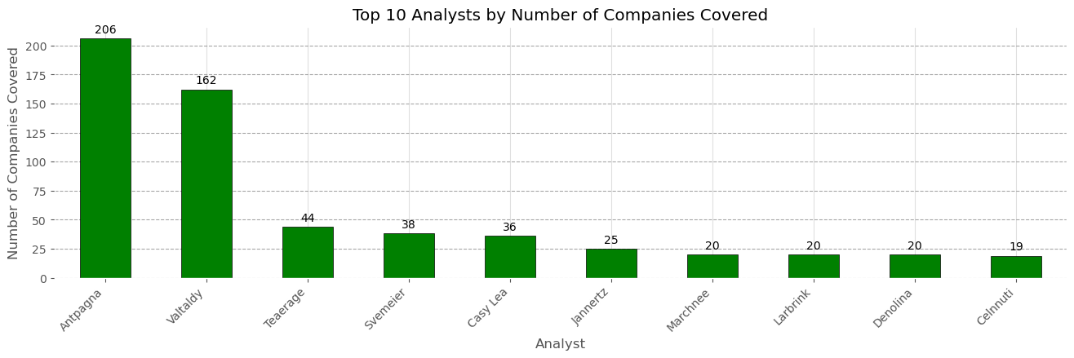
Project 3: Build a Better Company Classification Scheme (Q1 & Q2)
Data Analysis – Company & Analyst Coverage
Top 10 Companies by Number of Analysts Covered
Top 10 Analysts by Number of Companies Covered
Notes:
Firstly, let's look at our data analysis on company and analyst coverage. We identified the top 10 companies by the number of analysts covering them and the top 10 analysts by the number of companies they cover. The top company, ADS GR Equity, is covered by 44 analysts, while the top analyst, Antpagna, covers 206 companies. This initial analysis helps us understand the breadth of coverage and influence in the market.

Slide 28
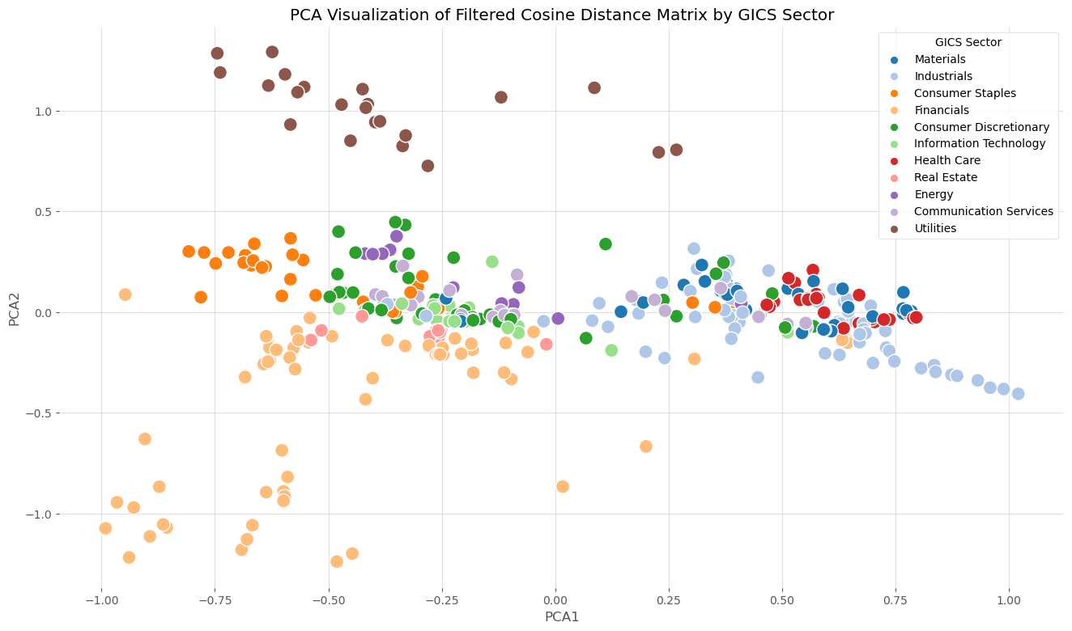
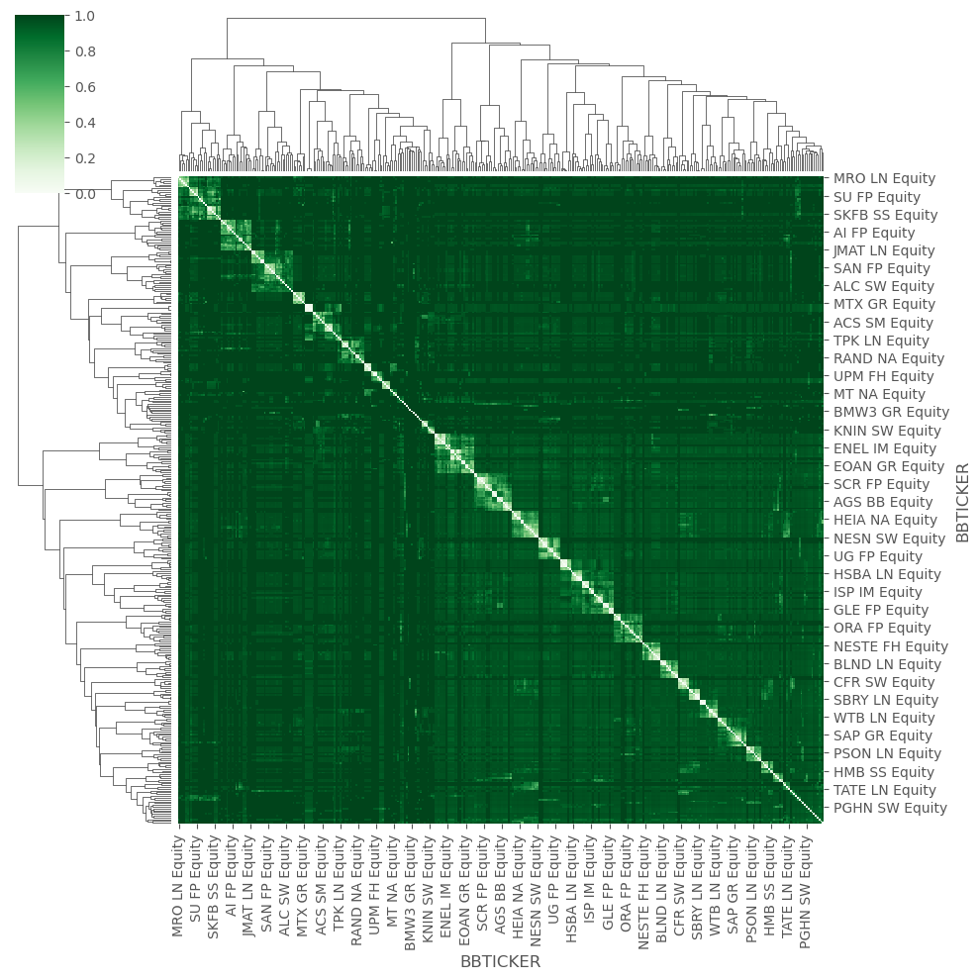
Project 3: Build a Better Company Classification Scheme (Q3a)
Distance Matrix Between the Companies Based on This Analyst Co-coverage (Without Restriction)
Method 1: Results are shown based on PCA
Method 2: Results are shown in dendrogram
Notes:
Moving on to the distance matrix between companies based on analyst co-coverage, without any restrictions. Using PCA visualization and dendrogram methods, we mapped out the cosine distance between companies. This visualization reveals clusters and patterns of similarity based on how analysts cover them, providing insights into natural groupings within our data.

Slide 29
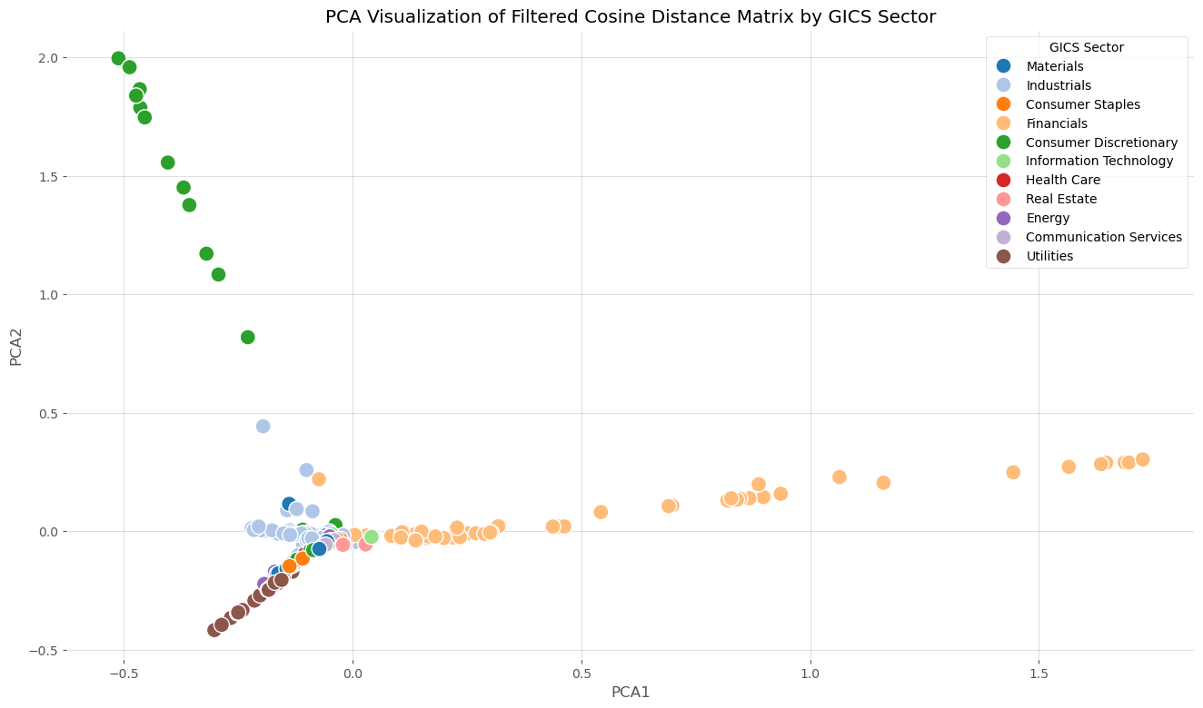
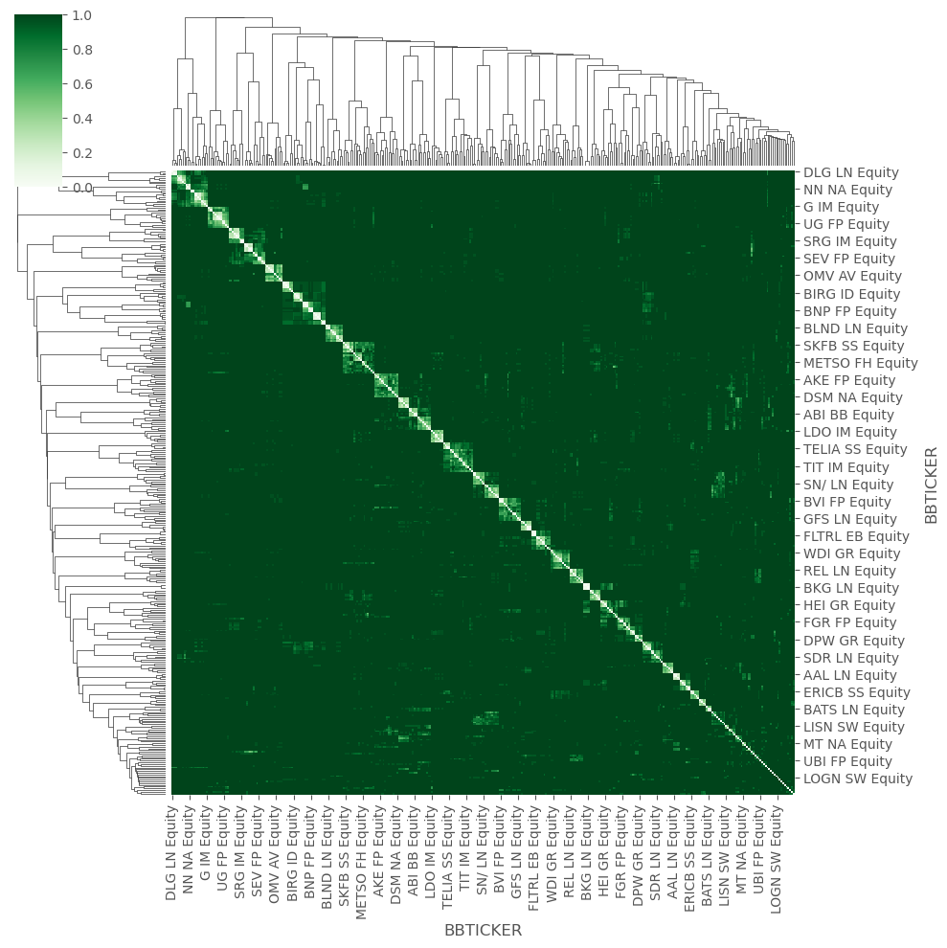
Project 3: Build a Better Company Classification Scheme (Q3b)
Distance Matrix Between the Companies Based on This Analyst Co-coverage (Restriction is Within 1 s.d.)
Method 1: Results are shown based on PCA
Method 2: Results are shown in dendrogram
Notes:
Next, we restricted the data to within 1 standard deviation of the mean. As we can see from the PCA and dendrogram, this filtering process reduces noise and brings out more defined clusters. It helps us focus on the core relationships between companies without the distortion of outliers.

Slide 30
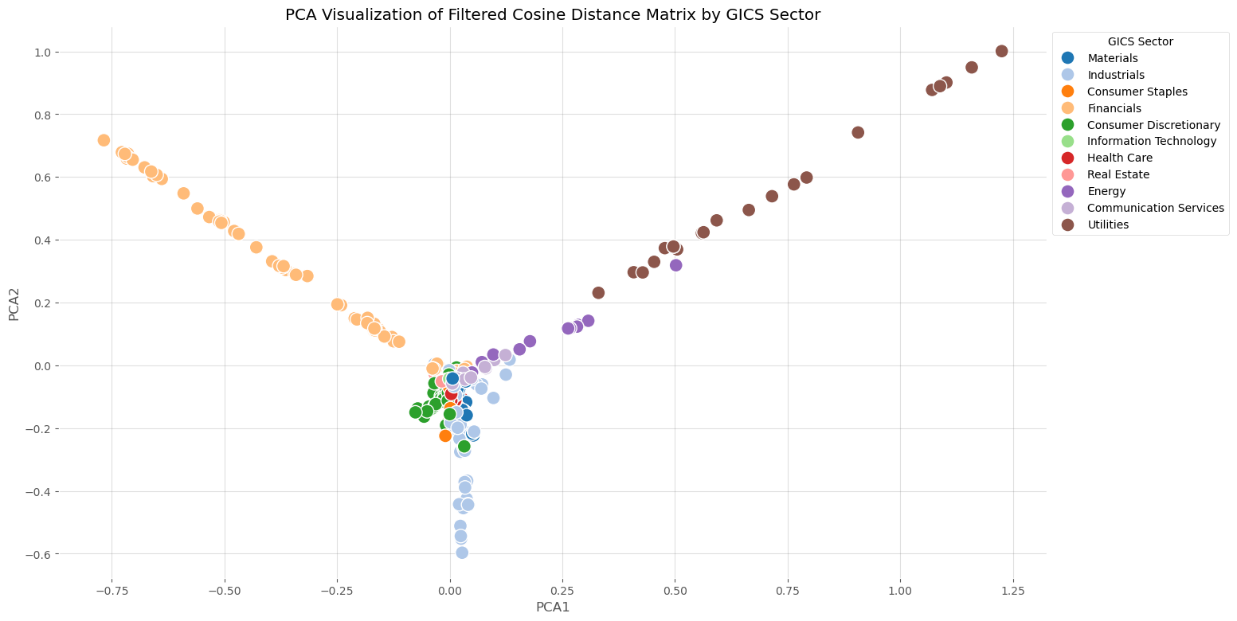
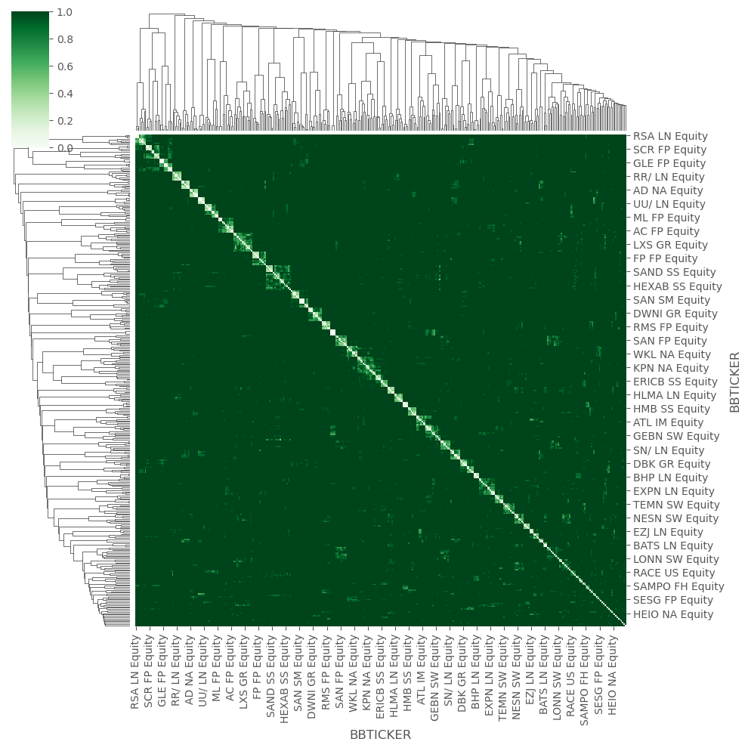
Project 3: Build a Better Company Classification Scheme (Q3c)
Distance Matrix Between the Companies Based on This Analyst Co-coverage (Restriction is Within 0.5 s.d.)
Method 1: Results are shown based on PCA
Method 2: Results are shown in dendrogram
Notes:
Further refining our data, we apply a 0.5 standard deviation restriction. This results in even more compact and distinct clusters, highlighting the strongest co-coverage relationships. Sectors such as Consumer Staples and Utilities show very tight, well-defined clusters, indicating a high degree of analyst agreement.

Slide 31
Project 3: Build a Better Company Classification Scheme (Q3)
Conclusion of Question 3
General Data Set
1 Standard Deviation (1 SD)
0.5 Standard Deviation (0.5 SD)
This graph includes the full data set without any filtering.
This graph includes data points that fall within 1 standard deviation of the mean.
This graph includes data points that fall within 0.5 standard deviations of the mean, representing the core of the data.
Characteristics
The data points are more dispersed, showing the complete variance present in the dataset.
The data points are less dispersed compared to the general data set. There is more compact clustering for sectors.
The clusters are even more compact compared to the 1 SD and general data sets. The data points are tightly packed around the mean.
Cluster
Observation
There are noticeable clusters for some sectors like Utilities and Consumer Staples, but overall, the data points are more spread out.
With the outliers removed, sectors like Information Technology and Consumer Staples show clearer and tighter clusters, indicating a more pronounced separation within 1 SD.
The most distinct, with sectors like Consumer Staples and Utilities showing very tight, well-defined clusters. The data points here represent the data set's most central and consistent part.
Sector
Separation
Ideas:
The compactness of the clusters increases as the filtering becomes stricter.
As filtering becomes stricter, the distinction between sectors becomes more apparent.
Filtering out data points beyond 1 SD and 0.5 SD reduces noise and focuses on the core variance within the dataset.
The density of data points increases as the filtering becomes stricter
Notes:
In summary of Question 3, we observed that as filtering becomes stricter, the compactness of clusters increases. This means that the distinction between sectors becomes more apparent, and the density of data points within clusters rises. It highlights how filtering can enhance the clarity of our classification scheme.

Slide 32
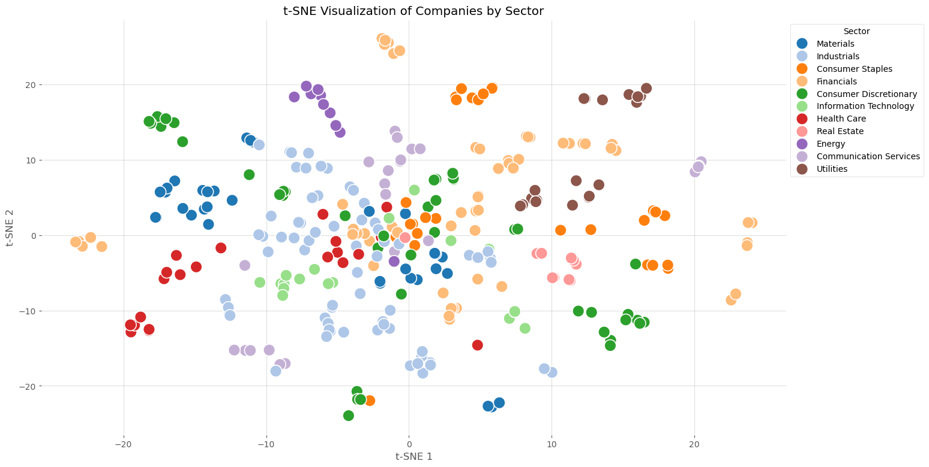
Project 3: Build a Better Company Classification Scheme (Q4 & Q5)
The Most Heterogenous & The Most Homogenous Sectors
Graph based on the provided t-SNE visualization
The most heterogenous sectors:
Consumer Discretionary
Companies in this sector are spread out widely, indicating significant variation within the sector.
The other two industries with high heterogeneity:
Financials
Communication Service
Q4
The most homogenous sectors:
Real Estate
Companies in this sector are closely clustered together, indicating high similarity.
The other two industries with high homogeneity:
Energy
Utilities
Q5
Sectors like materials have companies with similar profiles, while sectors like Consumer Discretionary exhibit greater diversity among their companies.
Notes:
Question 4 and 5 explore the most heterogeneous and homogeneous sectors. Using t-SNE visualization, we found that Consumer Discretionary is the most heterogeneous sector, indicating significant variation within it. On the other hand, Real Estate, Energy, and Utilities are the most homogeneous, showing that companies within these sectors have similar profiles.

Slide 33
Project 3: Build a Better Company Classification Scheme (Q6)
Outliers of the Clusters
Based on the DistanceToCentroid column, TEL NO Equity has the greatest distance from the centroid in cluster 3.
We can also find that there are most outliers from communication services, which is consistent with the outcome of Q4.
t-SNE 1 | t-SNE 2 | BBTICKER | GICS_SECTOR_NAME | Cluster | DistanceToCentroid
20.4695 | 9.751842 | TEL NO Equity | Communication Services | 3 | 15.2663
20.29436 | 9.175618 | TEL2B SS Equity | Communication Services | 3 | 14.66666
10.01358 | -18.2161 | IAG LN Equity | Industrials | 3 | 14.60502
20.26165 | 9.067652 | TELIA SS Equity | Communication Services | 3 | 14.55437
9.88933 | -18.1028 | EZJ LN Equity | Industrials | 3 | 14.53863
6.330512 | -22.2445 | GLEN LN Equity | Materials | 4 | 14.43921
-19.5076 | -11.9049 | ROG SW Equity | Health Care | 4 | 14.43215
6.230252 | -22.3471 | AAL LN Equity | Materials | 4 | 14.4222
5.800098 | -22.7984 | BHP LN Equity | Materials | 4 | 14.37236
9.47792 | -17.7226 | LHA GR Equity | Industrials | 3 | 14.32577
Notes:
Question 6 focuses on outliers within the clusters. Based on the distance to centroid metric, TEL NO Equity has the greatest distance from the centroid in cluster 3, indicating it as a significant outlier. Most outliers come from the Communication Services sector, aligning with our findings of high heterogeneity in this sector.

Slide 34
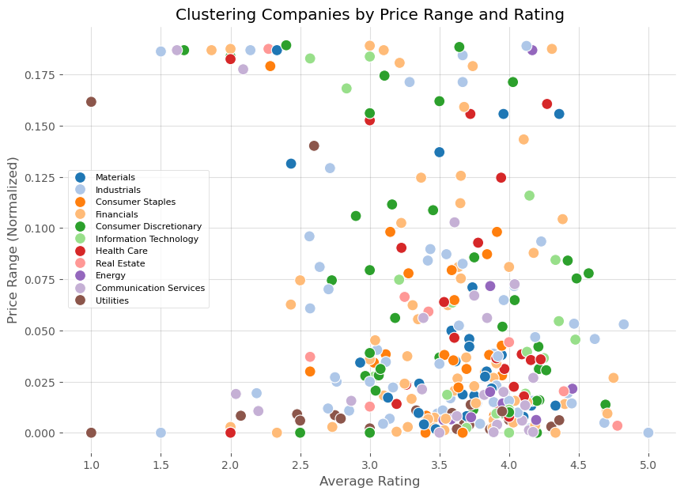
Project 3: Build a Better Company Classification Scheme (Q7)
Deeper insights – Relationship Between Price Range and Rating
Assumption:
Calculate the range based on the analyst-predicted price.
Larger price range
Higher risk
Lower rating
To prove it:
Calculated the price range for each company, then normalizing the price range.
Derived a Kmean clustering on the mean value of rating and price range.
Classified them with sectors
Conclusion:
The number of dots that Financials represents the most in the high-rating area with a small price range.
The number of dots that Industrials and Consumer Discretionary represents the most in the low-rating area with a large price range.
Notes:
For Question 7, we delves into the relationship between price range and rating. By clustering companies based on these metrics, we discovered that Financials tend to have a higher rating with a small price range, suggesting lower risk. Conversely, Industrials and Consumer Discretionary sectors often exhibit a larger price range with a lower rating, indicating higher risk.

Slide 35
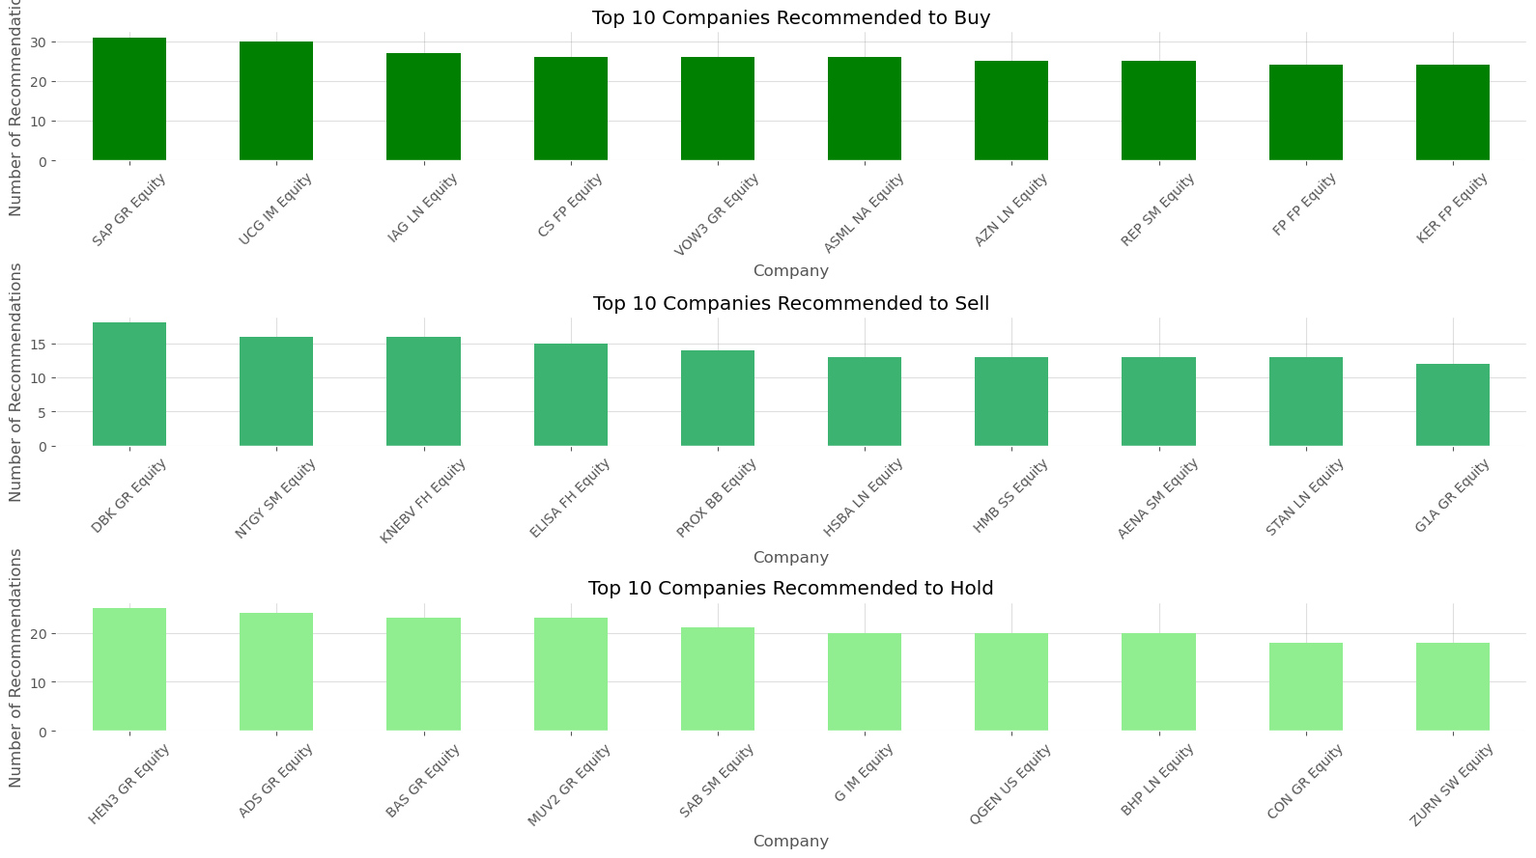
Project 3: Build a Better Company Classification Scheme (Q7)
Deeper insights – Deep Diving in Analyst Recommendations
Then we standardized the factors in ‘RECOMMENDATION’ to ‘Buy’, ‘Sell’, ‘Hold’ and ‘Not Rated’ only.
After that, we find the top 10 companies with the highest number of Buy/Sell/Hold recommendations.
Further, this could be utilized in public opinion analysis and quantitative strategy construction based on analyst perspectives.
Notes:
Lastly, we analyzed analyst recommendations, standardizing them into 'Buy', 'Sell', 'Hold', and 'Not Rated'. We identified the top 10 companies in each category. This analysis can be utilized in public opinion analysis and quantitative strategy construction based on analyst perspectives, providing valuable insights for investment decisions.

Slide 36
THANK YOU!
Notes:
Based on our analysis, the company classification scheme with the 0.5 standard deviation restriction emerges as the better scheme. This is because it provides the most compact and distinct clusters, which indicates a higher degree of similarity within each cluster. This scheme reduces noise, focuses on the core data, and offers clearer sector separation. Therefore, it enhances the reliability and accuracy of our company classifications, making it the preferred choice for our classification needs

